Slide 1
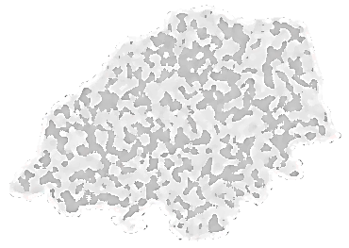



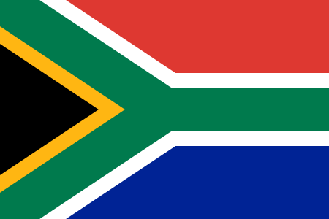
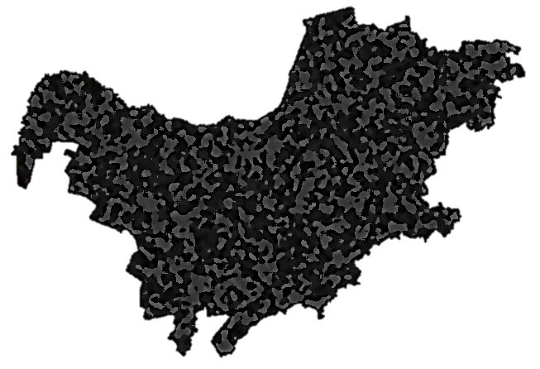
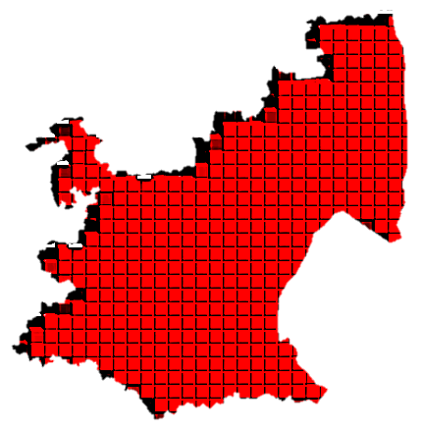

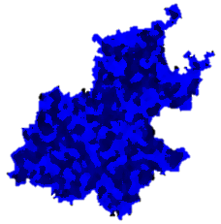




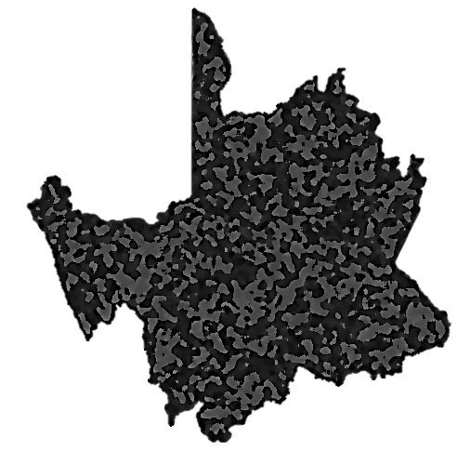
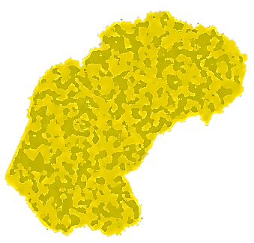
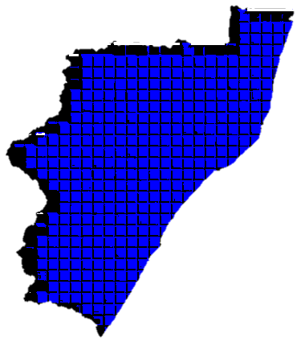


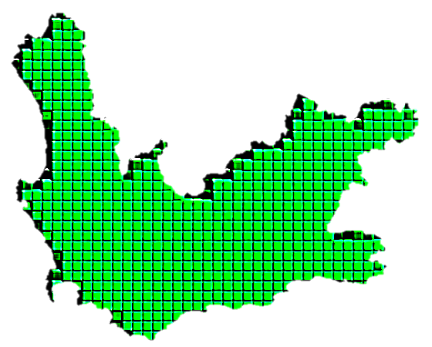
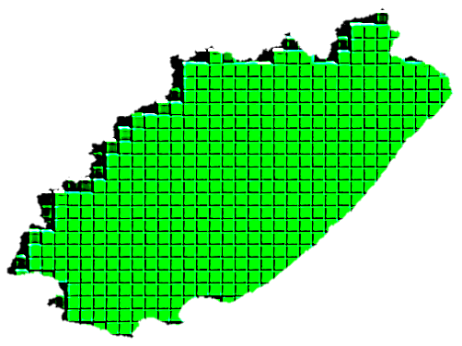





More than 10% of the Bantu population in the province speak this language
SOUTH AFRICAN BANTU LANGUAGE DISTRIBUTION
DOMINANT LANGUAGE | DOMINANT BRANCH OF LANGUAGE
SOTHO BRANCH
NGUNI BRANCH
TSONGA BRANCH
SESOTHO
SWATI
TSONGA
SETSWANA
ZULU
VENDA BRANCH
SEPEDI
NDEBELE
VENDA
XHOSA
SA

Slide 2
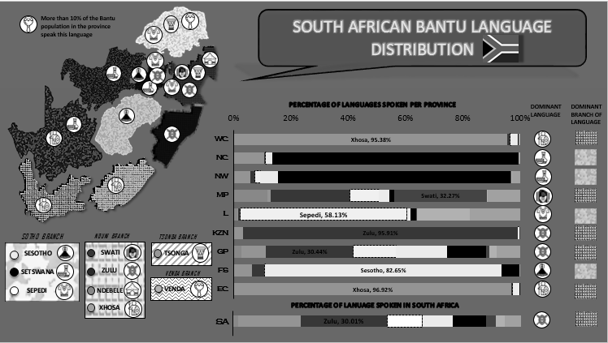

Slide 3

More than 10% of the Bantu population in the province speak this language
SOUTH AFRICAN BANTU LANGUAGE DISTRIBUTION
Xhosa
Province of Origin:
EC
Most speakers outside of province of origin:
WC
DOMINANT LANGUAGE | DOMINANT BRANCH OF LANGUAGE
SOTHO BRANCH
NGUNI BRANCH
TSONGA BRANCH
SESOTHO
SWATI
TSONGA
SETSWANA
ZULU
VENDA BRANCH
SEPEDI
NDEBELE
VENDA
XHOSA
SA

